Slide 2
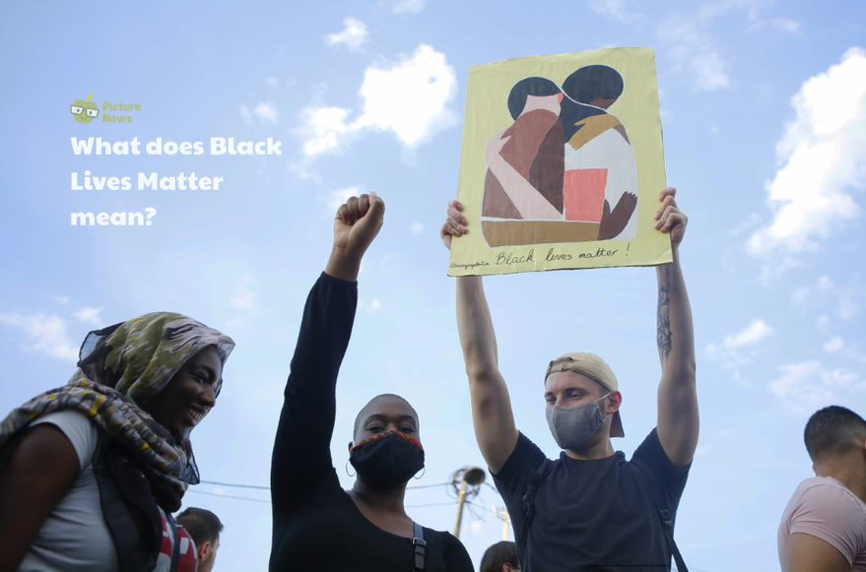

Slide 7
https://www.bbc.co.uk/newsround/52813673

