Slide 8
https://www.youtube.com/watch?v=y14JLAvW_fw

Slide 9
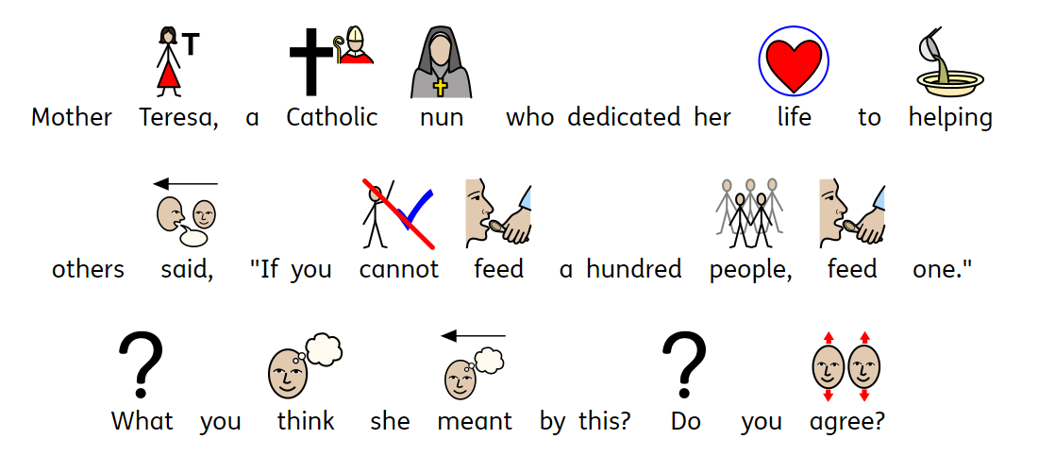

Slide 10
